Slide 1
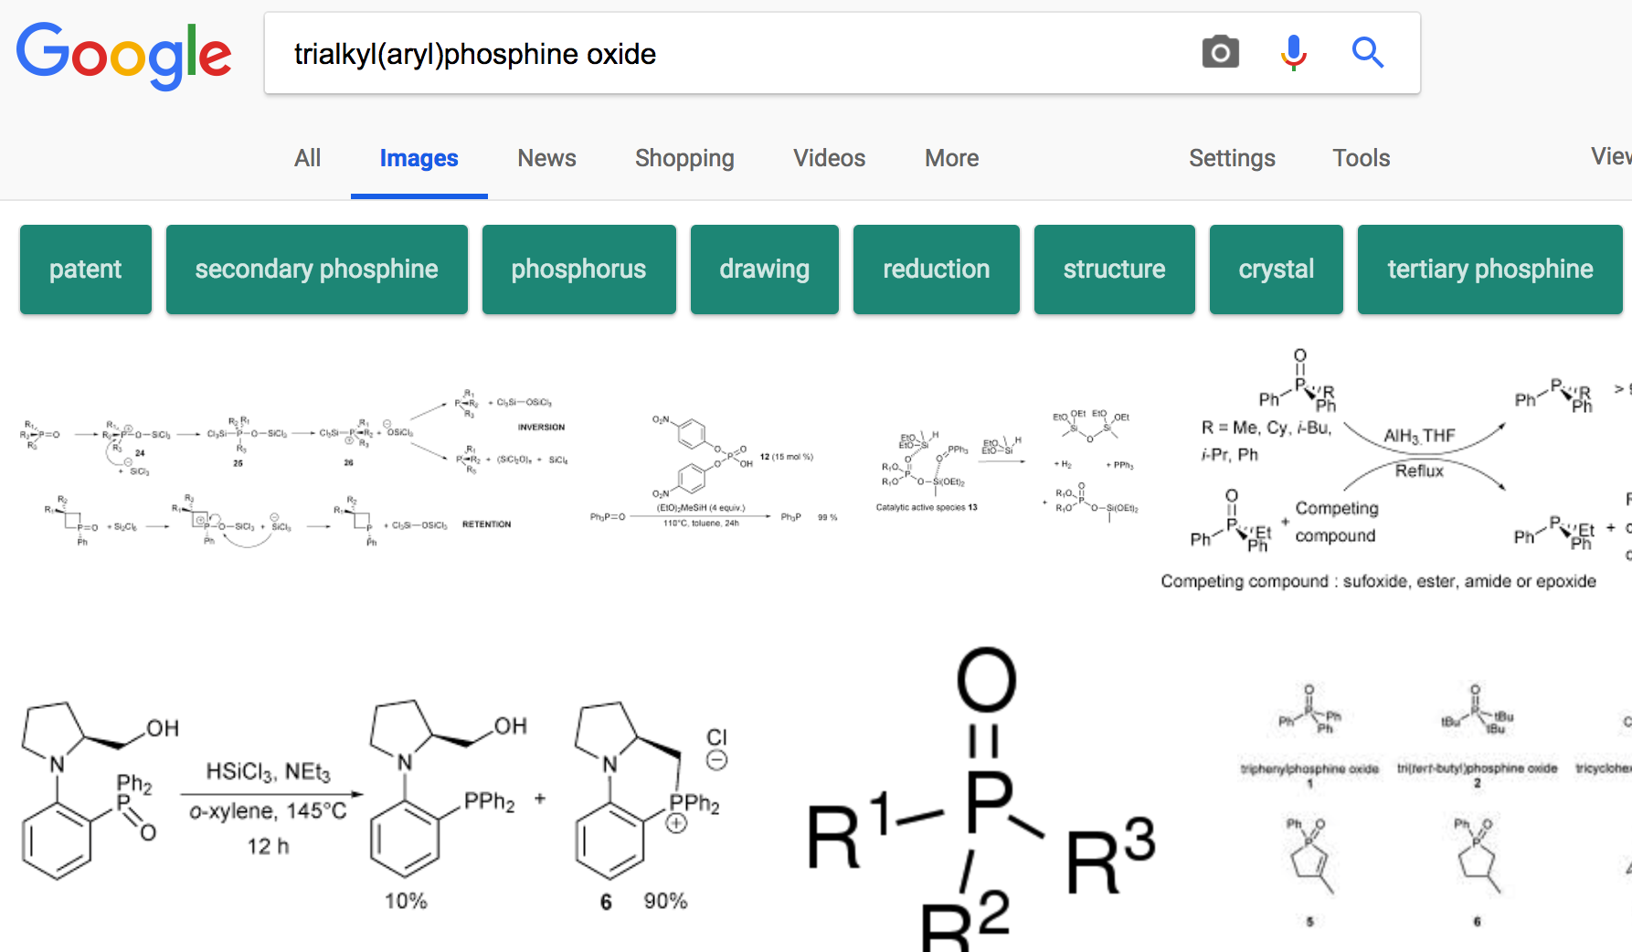
Find how to synthesis a new compound?
Google may not help much
How to efficiently find a image to illustrate the synthesis
route of a new compound that come out recently?
Search images on the web?
Find several literature paper and look through?
Build a knowledge base!

Slide 2
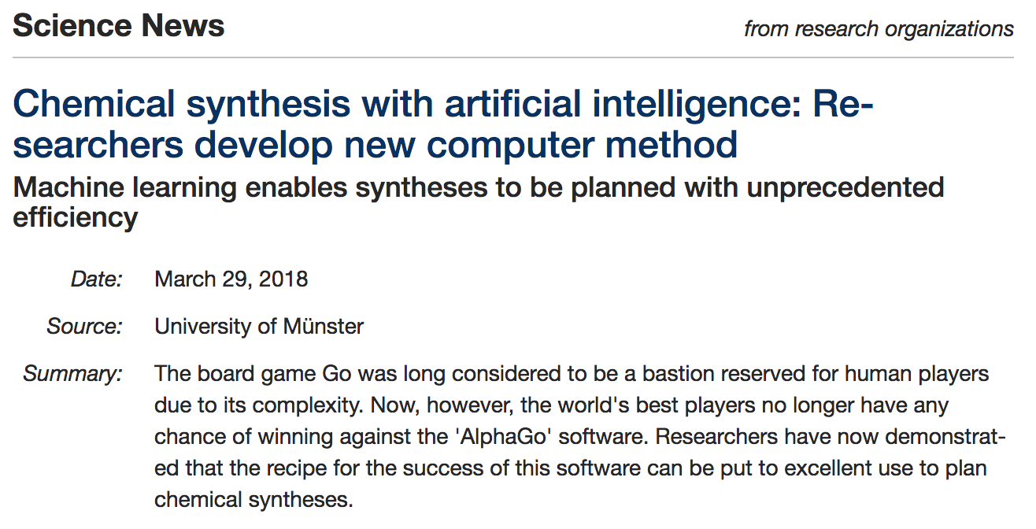

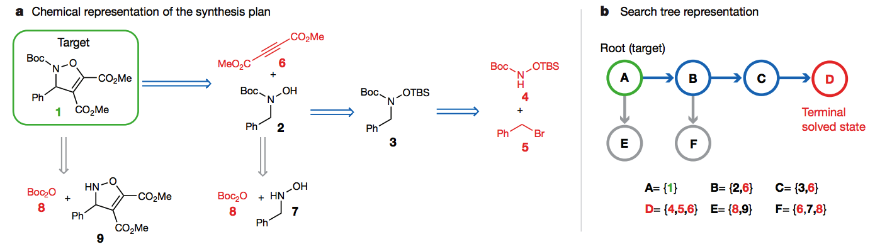
Knowledge Base Construction for Organic and Images with Synthesis Route
Collects the recent progress in synthesis of new organic compounds in academia
Users can search for the synthesis route of an unfamiliar organic compounds
Offers the opportunity for chemistry theorist to study/conclude the general mechanism
Can be used for training machine-learning models to predict the synthesis route

Slide 3
Find how to synthesis a new compound?

Slide 4
Resized original Image
Visualization of Histogram of Gradients
Visualization of Local Binary Pattern
Visualization of resized binary image

Slide 5
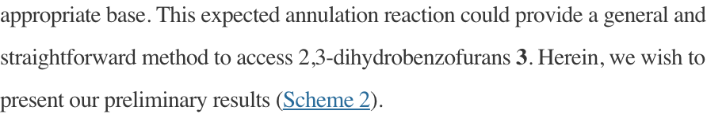
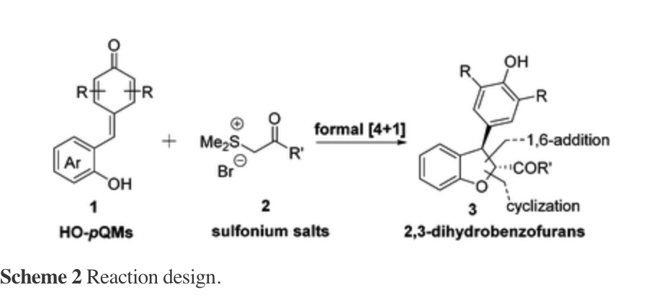

Slide 6
